Slide 1
Introduction to Worst Case
Loading and
Timing Analysis
©Paul Davies. Not to be copied, used, or revised without explicit written permission from the copyright owner.
This lecture may contain animations and is best viewed as a slide show

Slide 2
Introduction
Timing is probably more important to the success of a microcomputer design than it is to Comedy !!!
While it is possible to build and debug a 1-off computer system, such as a prototype, it is significantly more difficult to guarantee that a batch of such systems will all work, especially when you factor in the entire range of possible conditions that the components and system may be exposed to.
For example, the following factors can all make the exact run-time operation of each and every mass-produced chip and circuit board unique.
  Temperature.
  Electrical supply voltage.
  Capacitive loading.
  Variations in component Min-Max timing due to production tolerances
  Layout of chip/PCB (e.g. revisions).

Slide 3
There are many designs in production right now that probably have a significant number of unidentified potential failures due to a lack of a worst case loading and timing analysis during design.
Such failures, may be picked up during simulation and/or testing of initial prototypes or, as a last resort, in post-production testing as they come off the assembly line (assuming you are rigorous enough) but depends on volume and intended application – e.g. safety critical systems, as to whether all get rigorously tested.
Worst case, the failures may not show up in significant numbers until the product is out in the field where it may need to be recalled and replaced leading to major expense and loss of “good will” with customers.

Slide 4
Reasons for Timing Variation: Min-Max Component Tolerances
The most common cause of failure is variations in operational Timing
  Maybe 2% of all systems fail simply because they were built from a random batch of chips whose timing characteristics were at the extreme edges of manufacturers “min-max” tolerances.
  When a system is put together using these "unlucky" components, the timing of critical signals as they pass through gates in the circuit and around the PCB may be altered just enough to result in races, hazards and glitches. Worst case it may result in the clock to a flip-flop arriving before its data, resulting in failed operation. Most designers only build a few prototypes so they mostly miss this.
  These types of failures are hard to pick up just by observing the “actual timings" of a few random prototypes, or even during production when perhaps just 5% of boards are thoroughly tested.
  Good simulators can help in the design phase of say a chip (e.g. an FPGA or ASIC), but it is more difficult to simulate a complete system where accurate simulation models of each manufacturer’s chips may not exist, or more significantly, where the effects of PCB, component and track layout can be hard to simulate.
Good engineers therefore need a handle on factors that can influence the timing in their design, particularly for aspects that are hard to simulate.

Slide 5
Other effects that lead to timing variation
Revised PCB Layout: Designs have been known to fail, simply because the manufacturer revised the layout of a PCB, resulting in a critical/marginal signal being routed differently in the new design which subtly altered it's timings. The layout of very high speed circuits onto PCBs is a real skill and best left to someone with experience.
Revised Chip Layout: Similarly FPGA designs with tight timing tolerances in Quartus can fail when a different “fitter” algorithm/seed is used to lay out the interconnect within the chip, or when new circuitry is added that causes the fitter to change layout. The system is only as good as the simulation, which in Quartus means it ends at the pins of the FPGA. After that all bets are off as it travels down tracks on PCBs etc.
Admittedly, the likelihood of such problems occurring at low clock speeds (e.g. <10MHz) is relatively small, but beyond 1GHz, a variation in the length of a PCB track, or an interconnect in an ASIC by even just a few mm can be critical.
For example a 3Ghz signal has a wavelength = ~5cm on a PCB track (at ~ ½ speed of light). An oscilloscope placed in the middle of that track would show a signal “phase shifted” by 180 degrees. A signal at the end of the track is 1 complete clock cycle behind the same signal at the start of the track.
If a PCB track carrying that 3Ghz clock is shortened by say 1cm then the active edge of the clock could easily be shifted such that it occurs before the data arrives !!

Slide 6
F.Flop
Track Length = 4cm
Chip
Chip
CLK
D
CHIP
CHIP
Data Track Length = 4.0 cm. A simulation shows data leaving source and arriving at f.flop before clock (good)
PCB Layout 1
Track Length = 4cm
F.Flop
Chip
Chip
CLK
CHIP
CHIP
D
Data Track Length = 9cm
Data arrives 1 full clock period after clock @3GHz (wrong data gets latched)
PCB Layout 2

Slide 7
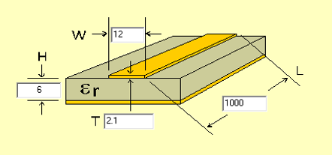
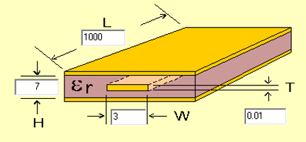
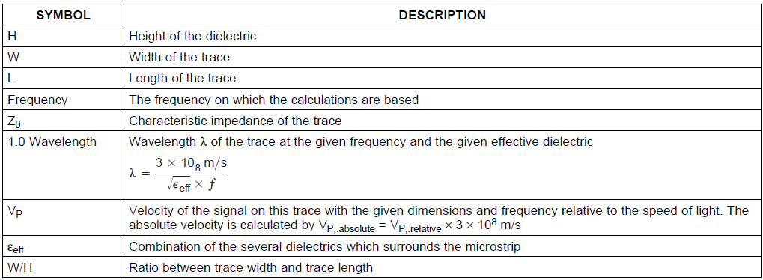
Reasons for Timing Variation: PCB construction material
The speed at which a signal propagates along a PCB track is a function of the track geometry and the material from which is it constructed, i.e. its characteristic impedance Z₀. Two commonly used but different PCB construction techniques (microstrip and stripline) are shown below.
Microstrip
Stripline
7

Slide 8
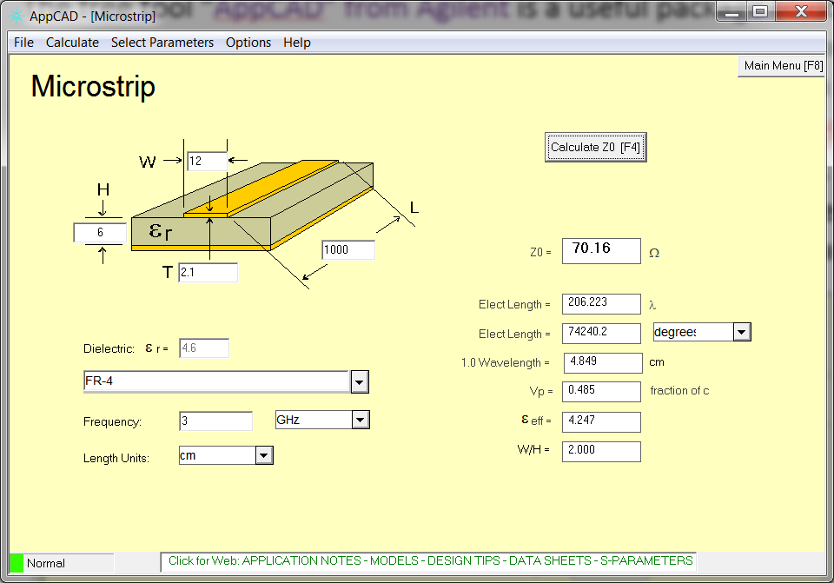
The free tool “AppCAD” from Agilent is a useful package to download and experiment with, when determining how dielectric, and track construction affect the propagation speed and characteristic impedance Z₀ of a copper track on a circuit board.
The example below shows an FR-4 Microstrip PCB (en.wikipedia.org/wiki/Microstrip) construction. FR4 is a glass-reinforced epoxy laminate sheets (en.wikipedia.org/wiki/FR-4) the most common PCB construction material.
Signal speed V_{p} is slightly less than ½ the speed of light.
Knowing the speed we can work out propagation delay.

Slide 9
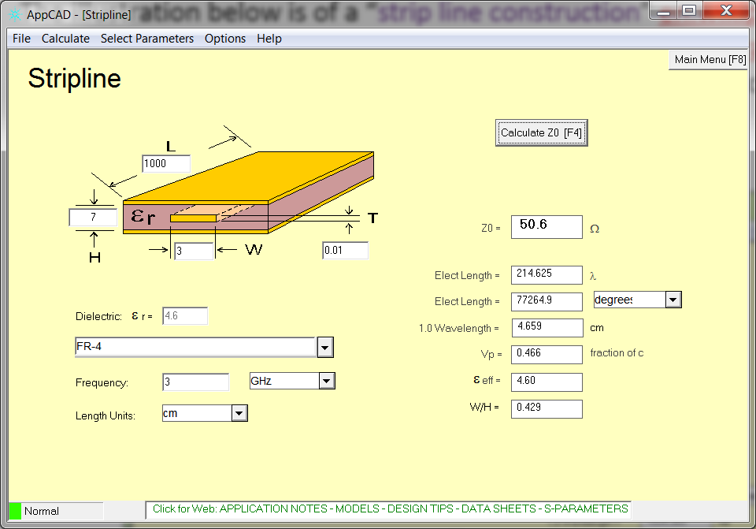
The illustration below is of a “strip line construction” en.wikipedia.org/wiki/Stripline which uses a flat strip of metal sandwiched between two parallel ground planes. This technique, although more expensive to manufacture, leads to better/reduced EMI at higher frequencies compared to mirostrip construction.
Speed is slightly less than ½ speed of light.

Slide 10
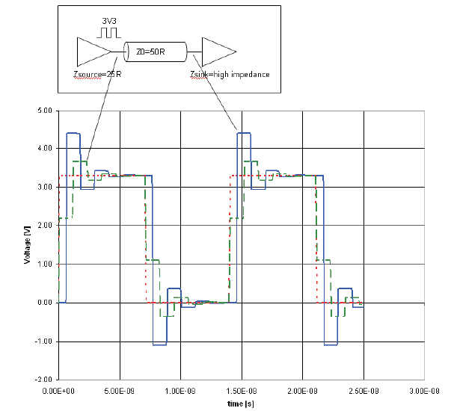
Impedance mis-matching between chips and PCB tracks can lead to reflections of signals that exhibit fast rise/fall times (i.e. signals associated with high speed circuits).
The effects of these reflections can lead to a partial cancelling of the propagating signal’s “voltage wave front”, i.e. the leading edge of the signal, resulting in slower rise/fall times (red signal is the source, green signal is entering PCB track, blue signal is at receiver) and hence increased propagation times (time to register a logic 0 or 1 at other end)
We’ll return to this subject in a later lecture.

Slide 11
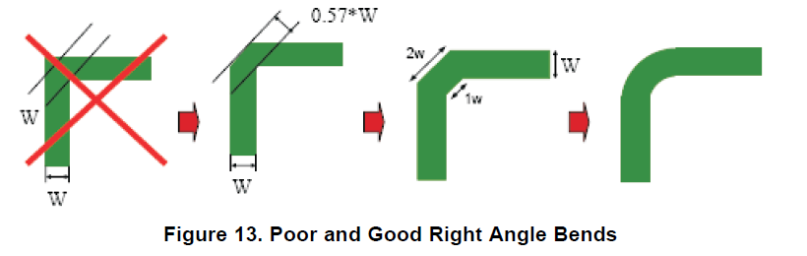
PCB Track layout affects Propagation delay and also EMI
Layout of PCB tracks can also affect propagation delays of signals, particularly at sharp/abrupt corners where reflections back towards the source can occur cancelling the incoming voltage front and resulting in signals that take longer to rise an fall at the destination.
Abrupt corners can also lead to increased EMI at higher frequencies.
Both undesirable side effects can be reduced by making the corner more “rounded”. Something to “bear in mind” when laying out a PCB.

Slide 12
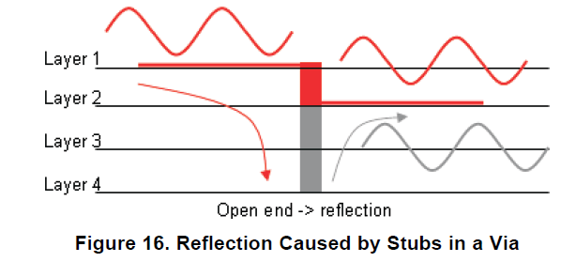
Using “vias” on PCB tracks http://en.wikipedia.org/wiki/Via_%28electronics%29
The use of vias is essential in most PCBs to connect signals on one layer to signals/tracks on another and they generally pass right through the board.
A PCB designer has to be careful using them as they add additional inductance and capacitance, giving rise to reflections due to the change in the characteristic impedance at each end of the via. Particularly if the via ends up being a “stub” with no electrical connection.
Vias also increase the trace length (connections between layers) leading to further delays.
Cross section of a 4 layer PCB
Open ended via or “stub” causes increased reflections due to abrupt change in characteristics and slows signals speed

Slide 13
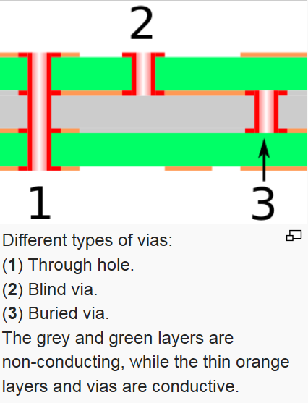
Tips for routing tracks and the use of vias:
Do not use 90⁰ corners on tracks with fast rise times.
Ensure tracks on different layers of the PCB are routed at 90 degree angles to each other (e.g. east-west on Layer 1, north-south on layer 2 etc.) to avoid signal coupling.
To minimize crosstalk, the distance between two tracks on the same layer should be approximately 2 to 3 times the width of the track.
Differential signal tracks should be routed as close as possible to get a high coupling factor – leads to increased noise immunity due to common mode rejection of noise.
Do not use vias on traces with sensitive signals
Consider stubs created by vias - use blind vias or buried vias.

Slide 14
Other Reasons for Timing Variation: Temperature, Power supply variations and Loading
Most manufacturers quote their chips min-max timings only for a specified Temperature, Voltage and Capacitive load value.
Could you predict how your circuit timings will vary if these factors are altered? If you are lucky the manufacturer will tell you, if not then prepare for some possible failures if your design does not take these variations into account.
Do you know for example what the actual voltage is, at the power pins of every chip on your PCB and what factors affect it? You may assume it’s 5v or 3.3v etc. but have you actually measured it. What can you do to improve it (hint: think about how you route power to your chips)?
What is the operational temperature of your circuit – how are circuit timings affected by temperature?
What is the capacitive loading on critical signals and how do all these things affect timing – more capacitive loading slows the rise and fall times of signals as the capacitance charges and discharges through the output resistance of the transistors driving the load?

Slide 15
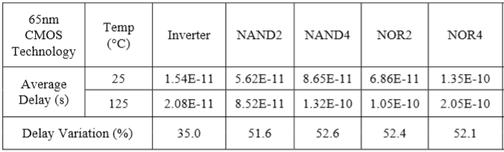
Factors affect Propagation Time: Temperature
  Devices tend to get slower as temperatures rise, this is a physical effect, due to increased resistance change in Mosfets due to reduction in electron mobility, resulting in lower currents and slower switching times. This goes some way to explaining why computers fail as they get hotter, perhaps after they have been working OK for several mins.
  For some IC families, their propagation delays change by ~2nS over the entire temperature range of -50ºC to +100ºC which is significant at very high frequencies.
  It also explains why “Over clockers” (who try to raise the clock frequency of their CPU above manufacturers recommended maximum generating more heat), often have to resort to liquid cooling to keep the chip functioning at it’s fastest speed.
  Tests for propagation delays are generally quoted by the manufacturer at room temperature e.g. 25 degrees C but you might have to consider the effect for other temperatures.
http://ihome.ust.hk/~eekursun/papers/c25.pdf

Slide 16
Factors affect Propagation Time: Power supply voltage
  A change in propagation delay might also be expected as V_{cc} (supply voltage) varies between it's minimum and maximum operational values, the exact value varies from chip to chip.
  Reduced supply voltage at the chip (i.e. below manufacturers recommended operating voltage) may be as a result of poor power distribution on the PCB. Wider power tracks or better still, separate power/GND planes lead to reduced power line resistance, which in turn leads to less voltage drop at the chip.
  Increased chip voltages lead to increased currents (generating more heat and stressing the chip), which allow the transistors to switch state more rapidly since the increased current leads to faster charging/discharging of signal capacitance (loads), i.e. it affects the slew rate of the device.
  Over-clockers often have to raise the motherboard voltage to achieve higher clock frequencies while force-cooling the resulting hotter circuit.
  Values quoted by the manufacturer are those for the device operating at it’s recommended supply voltage, if you know it will operate outside that, then ideally you take it into account.

Slide 17
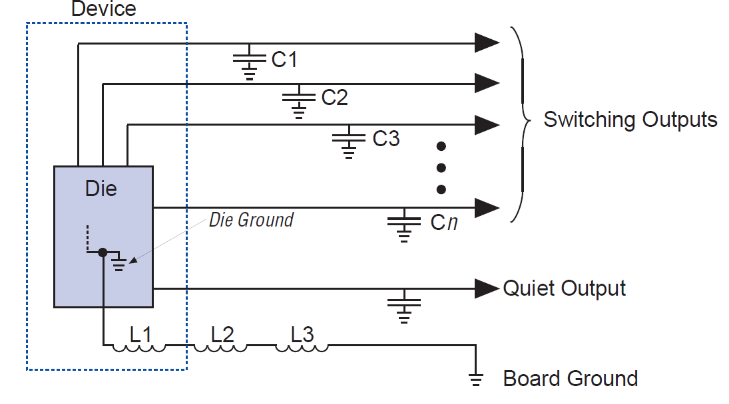
Factors affecting Propagation Time: Number of outputs pins switching simultaneously
  The number of output pins that simultaneously switch from high to low within a chip can have an effect on the propagation delay of each individual output. e.g. take an 8 bit counter rolling over from 11111111 to 00000000 is an example.
  This is due to the inherent inductance associated with the ground lines feeding the chip. The illustration below shows several output signals with inherent capacitance all currently charged to logic ‘1’. When they switch together a large momentary current is created in the chip as it tries to discharge those capacitors. This current flows via the chips GND pin into the board.
  The inherent inductance of the Ground signal creates a back emf which can lead to a small reduction in the supply voltage inside the chip due to “ground bounce”. This results in momentarily smaller operating voltages, reduced slew rates and longer discharge times for the capacitors. For example 74AHCTxx families add 0.25ns per output switching.
  This explains why complex chips have many Vcc and Gnd Pins.
L1 = Inductance of bond wire in the chip from devices ‘die’ to the package pin
L2 = Inductance of the package pin to the PCB ground signal. This is greatest when the device in placed in a socket
L3 = Inductance of the PCB track back to the power supply ground reference.
Ground bounce can also cause “quiet output” signals (those at logic 0) to momentarily rise which could trigger other logic. Use gray code counters or series resistors to limit number of outputs switching and current.

Slide 18
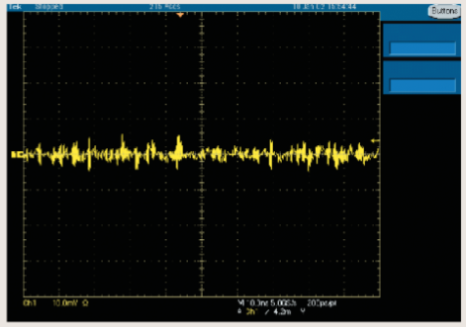
Ground Bounce captured on an oscilloscope due to excessive chip currents and/or high resistance in PSU or ground plane.

Slide 19
What if you can’t measure, simulate or take account of everything? : Soak Testing
When it is hard to factor in all the various parameters, manufacturers will sometimes resort to submitting each produced system to a Soak test as a way of weeding out flaky systems after assembly – but it's expensive, it’s not a substitute for better design.
Soak or “Burn in” Testing involves testing under stress, e.g. extremes of Temperatures, Capacitive Loading and Supply Voltage etc. This is particularly important in safety critical systems, e.g. Nuclear Power Stations, Railway Signalling, fly by wire aircraft etc. It also helps to identify systems that would fail early in their life.
Designing for Worst Case
A worst case design would attempt to take account of as much of the information that is available, as possible, regarding the component variations in tolerances and timing.
If this approach is adopted, then even when all component parameters are at their most adverse values, or anywhere in between, a worst-case design in theory should always work.
If such a detailed analysis, is not undertaken then there is no way of knowing if the design will work reliably when it is mass produced and subjected to differing environments.

Slide 20
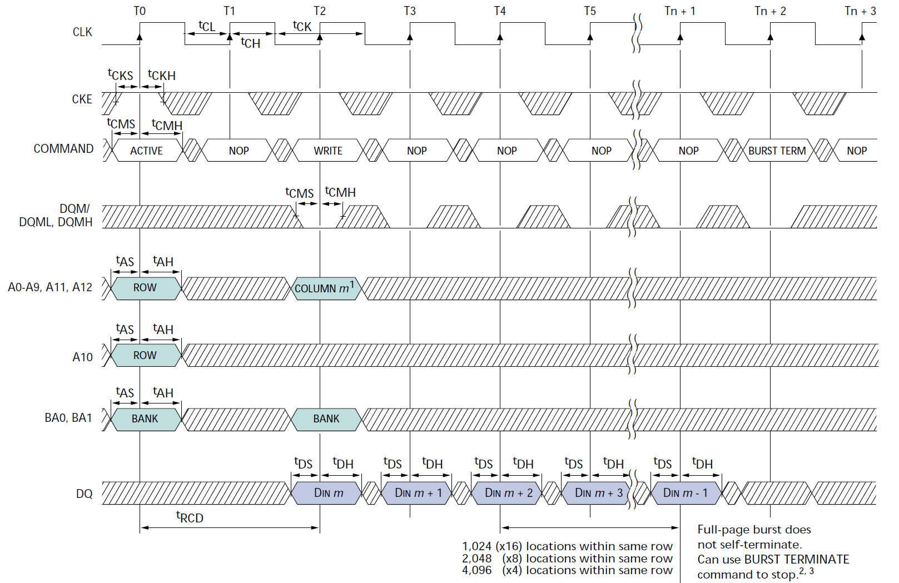
Timing Diagrams
To design for worst case, an Engineer must be able to understand and perform detailed timing analysis of manufacturers data sheets. Simulation results can then be compared to data sheets to verify timing (we do this in Assignment 1). Can you interpret this timing diagram, what do the signals and timing parameters mean and which of them are important?
An SDram Memory chip Timing diagram

Slide 21
Timing Concepts
Every microcomputer system design engineer should have a handle on at least the following very important timing concepts and what can cause them to vary.
Knowledge of these is essential to an understanding of how to interface CPUs to say memory systems, motherboards and backplanes.
  Slew Rate of a signal.
  Propagation Delay (Latency) of a signal.
  Setup and Hold time (Meta-stability issues)

Slide 22
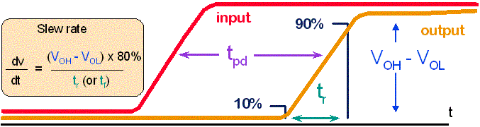
Slew rate: Causes and Effects on Timings
  The slew rate of an output signal is the rate of change of it's output voltage dV/dt, or more usefully is quoted as the time it takes an IC to switch from say 10% (V_{OL}) to 90% (V_{OH}) and vice-versa of it's final value i.e. from logic 0 to logic 1.
  In other words, even if the circuit has made the decision internally as to what the output should be, it still takes time for the output transistor(s) to switch state and change the voltage at the end of the wire from one logic level to another.

Slide 23
Factors affecting Slew Rates
  A circuit has to charge and discharge the inherent capacitance of the load (gates and PCB tracks) connected to the output signal via the output resistance of the transistor driving the signal (as well as fight the back emf due to the inductance of any wires attached to it). Thus increased capacitive/inductive loads slow the ‘rise’ and ‘fall’ time of the signal.
  Manufacturers may quote the rise and fall times for an output signal but only a specific capacitive load. Differences, particularly in capacitive load can then be taken into account by you.
  SIGNAL rise/fall times proportional to e^{-(1/RC)}
  The move to lower supply voltages (3.3v and more recently 1.8v) means the 10% to 90% values are reduced, consequently output signals switch state faster when designed to operate at lower voltages. (That’s different to lowering the voltage from the one specified by the manufacturer).

Slide 24
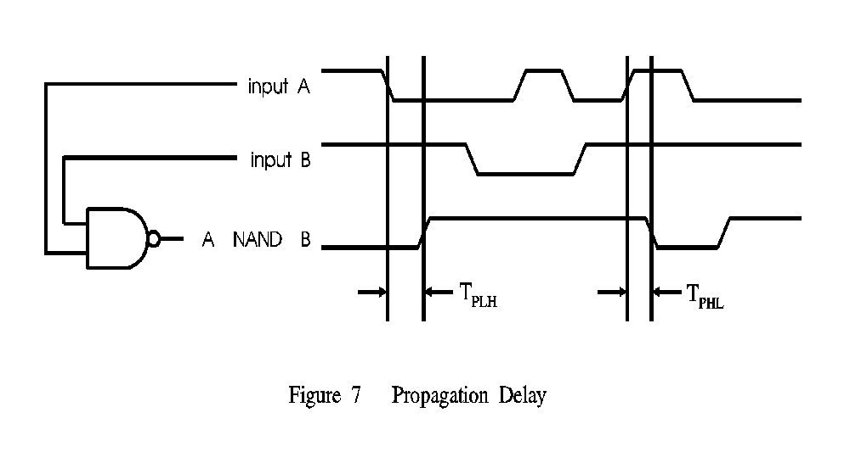
Propagation Delays (Latency)
A propagation delay is a measure of the time taken for a change at the input of a device to effect a change at the output. Even wires, exhibit some delays.
Not all devices have symmetrical delays for positive and negative transitions.
In the diagram below, the propagation delays for a high to low transition (T_{PHL}) are shorter than for a low to high transition (T_{PLH}).
This asymmetrical delay is common for TTL devices (note CMOS devices tends to have more symmetrical timings) open collector and open drain outputs because they are better at sinking current than sourcing it. Rise times for an open drain output are notoriously slow due to the pull up resistor being used to charge load capacitances.
Serious timing issues can arise if a number of devices are cascaded all exhibiting their min (or max) propagation values. Under such circumstances, one signal can race another, perhaps overtaking it and arriving before (or after) it is required.
T_{PLH}
T_{PHL}

Slide 25
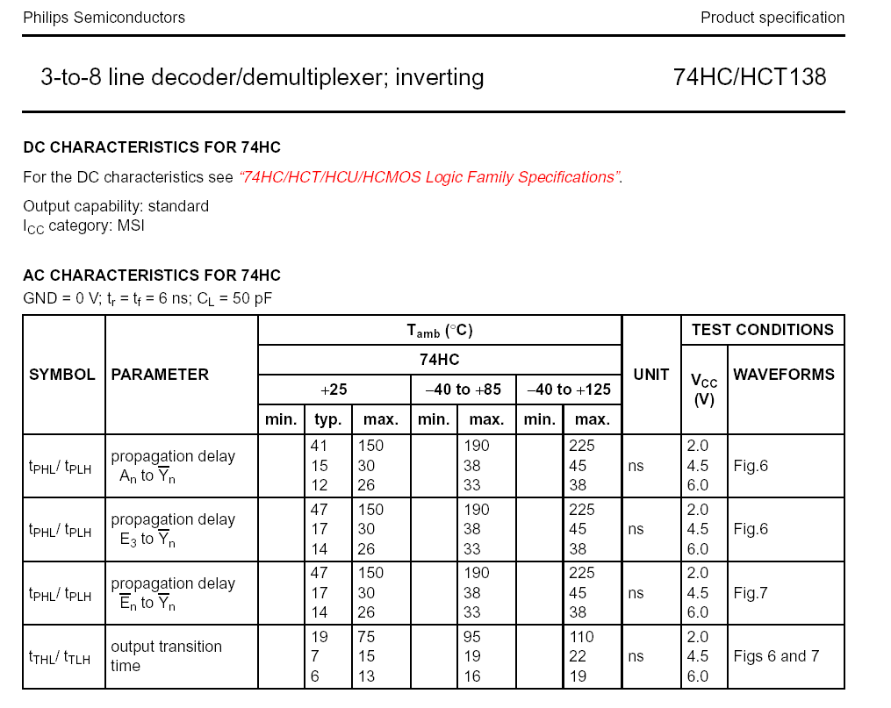
Note rise and fall times specified for a particular capacitive load
Note variation in times with temperature
Note variation in times with Voltage

Slide 26
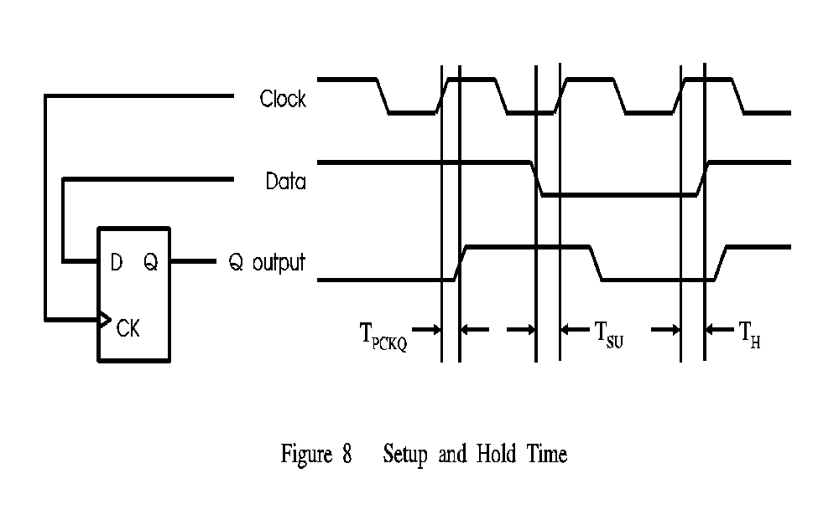
Synchronous (clocked) Systems
A huge problem in synchronous systems is ensuring that flip-flop setup and hold times are not violated
  Setup time (T_{SU}) is the length of time the Data input to the flip-flop must be valid and stable, prior to being clocked.
  Hold time (T_{H}) is the length of time the Data input to the flip-flop must be held valid and stable, after being clocked.
If setup or hold times are violated, the Q output may become invalid or even oscillate, a condition referred to as metastability (see on-line Application note on metastability by Altera)

Slide 27
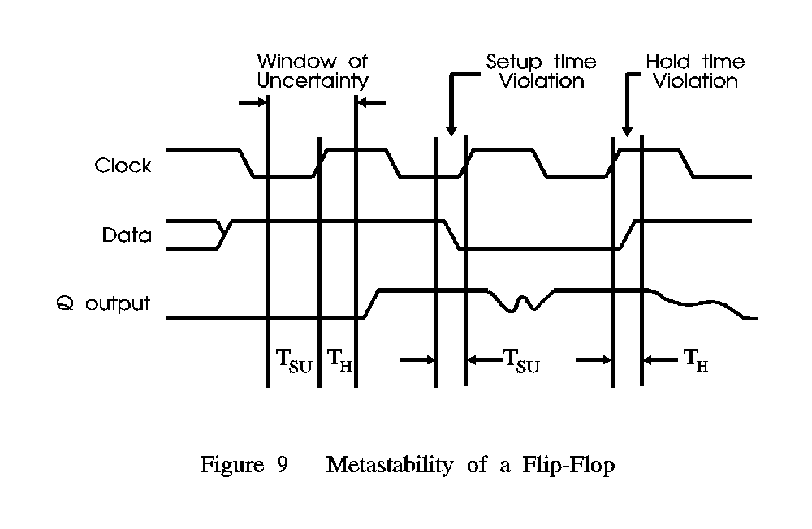
Metastability
The illustration below shows what can happen to the output of a Flip-Flop when it’s Set-Up and/or Hold-times are violated. This is a particularly important consideration in synchronous (clock driven) systems.
When either of these times is violated, the output may take an invalid level, or more commonly oscillate for a undefined period of time. (Read article from Altera on course web-site)
Metastability Problem
Active edge of Clock
setup and hold times met
Active edge of Clock -
setup time violated, possible oscillation in output
Active edge of Clock
hold time violated, possible oscillation in output

Slide 28
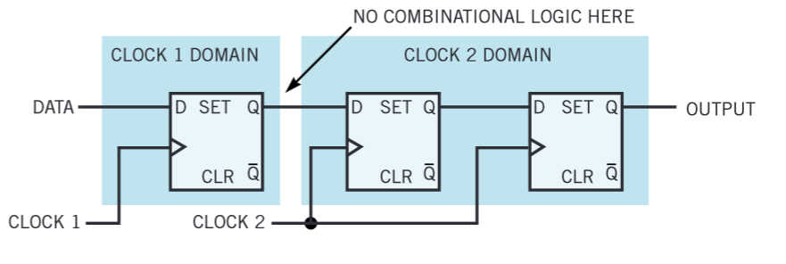
Tolerating Metastability
It has been shown that once a flip flop enters a meta stable state, the probability of being in that state some time later decreases exponentially with time.
When an asynchronous input arrives at a flip flop, perhaps from the real world, or from another circuit driven by a different clock (i.e. a signal crosses a clock domain) there is a possibility that it will induce metastability. The probability of this problem propagating to another part of the circuit can be reduced by having synchronising logic, such as that shown below.
Synchronizer circuit
http://m.eet.com/media/1137372/17561-310388.pdf

Slide 29

Draw the min/max timing diagram for the output of the following circuit assuming nominal temperature and voltage supply and no adverse capacitive loading on any output.
100ns
IN
OUT
Solution:
Parameter | Min | Max
t_{PHL} | 5ns | 10ns
t_{PLH} | 10ns | 20ns
100ns
In
40ns
50ns
Out
20ns
25ns
105ns (fast chip)
110ns (slow chip)

Slide 30
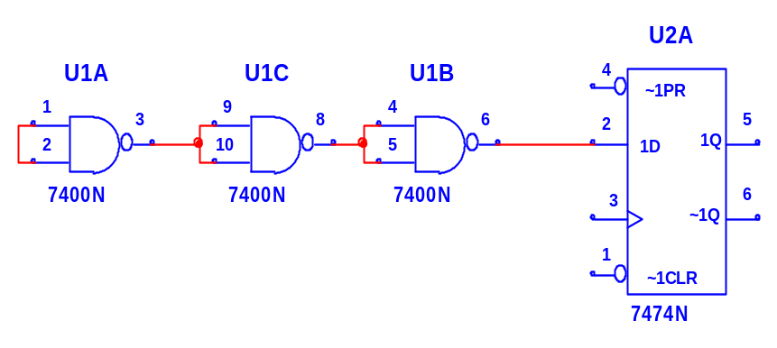
Given the timing variation inherent in the Data signal below, is it possible that the Setup or Hold time of the D-Type Flip Flop could be violated?
10ns
Data
5ns
Data
70ns
CLK
45ns
CLK
Nand Gate
D-Type
Parameter | Min | Max
t_{PHL} | 5ns | 10ns
t_{PLH} | 10ns | 20ns
Parameter | Min | Max
t_{SU} | 15ns
t_{SH} | 10ns
Solution: The is a classical ‘race’ problem where the Data at the flip flop must arrive at least 15ns (worst case setup time) before the ‘Clock’. First calculate the variation in signal timing at the ‘D’ input to the flip-flop
The fastest path to the D input signal is 5 + 5 + 10 + 5 = 25ns
The slowest path to the D input signal is 10 + 10 + 20 + 10 = 50ns.
To violate the setup time, the CLK signal would need to change less than 15ns after data. One possible example is that the data is at it’s slowest (50ns) and the CLK changes anywhere between 50ns and 65ns
To violate the Hold time the D would need to change within 10ns of the clock arriving. This is possible if the data is slow and arrives at say 50ns and the clock arrives at 45ns.

